Slide 1
Count forward from 10 up to 19
K.CC.A.2

Slide 2
Students will:
Count forward beginning from 10 up to 19.
Using hops and number line to count forward.
Word Wall :
Add
Count forward
Number line

Slide 3
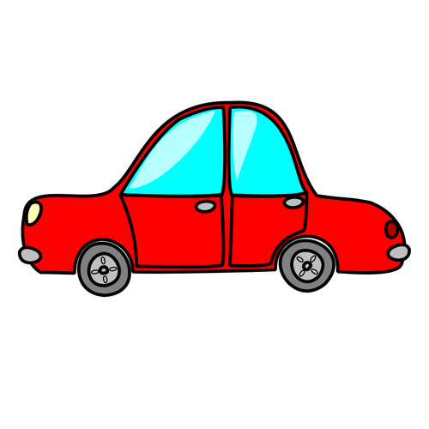
Can you count from 6 to 10?
6
6

Slide 4
We can count forward by using an object like a car on a number line!
6
7
8
9
10
6
7
8
9
10

Slide 5
In this lesson, we will learn how to count from 10 to 19 by hopping with a frog!
Last time we used a car to count…
This time we will count with a… frog!

Slide 6
The frog is sitting on number 10.
Let me show you!
10
He’s ready to hop!

Slide 7
Hop again! Now we are on 12.
Hop one more time! Now we are on 13.
Let’s hop once! Now we are on 11.
Hop one last time! Phew, we are on 14!
10
11
12
13
14

Slide 8
Which number is the frog sitting on?
Let’s try this one together!
He’s sitting on number 11.
11
Are you ready to hop?

Slide 9
Let’s hop forward!
Hop again! Now we are on 13.
Hop one more time! Now we are on 14.
Let’s hop once! Now we are on 12.
Hop one last time! Phew, we are on 15!
11
12
13
14
15

Slide 10
Which number in the frog sitting on?
Now you try it!
12
Are you ready to hop?

Slide 11
Can you hop with the frog and count to 16?
Hop again! Now where are you?
Hop one more time! Where are you now?
Let’s hop once! Where are you guys now?
Hop one last time! Finally!
12
__
__
__
__

Slide 12
Which number in the frog sitting on?
13
Are you ready to hop?

Slide 13
Can you hop with the frog and count to 17?
Hop again!
Hop!
Hop once!
And...hop again!
13
__
__
__
__

Slide 14
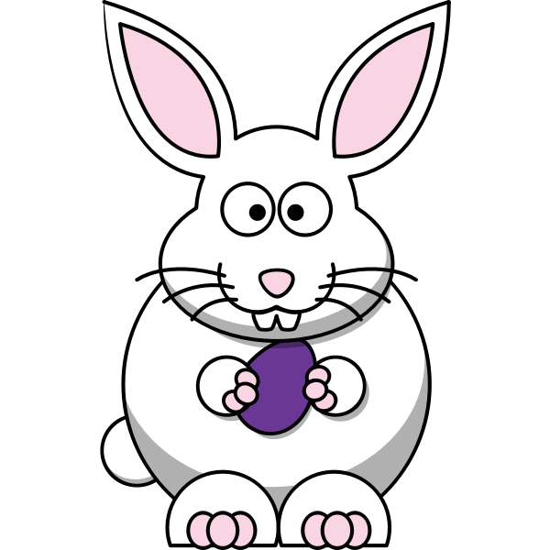
Now this little rabbit wants to join our hopping party!
Which number is she sitting on?
13
Let’s hop with her!

Slide 15
Can you hop with the rabbit and count to 18?
Two hops!
Three hops!
One hop!
Three hops!
14
__
__
__
__

Slide 16
Let’s hop one last time with the rabbit!
Which number is she sitting on?
15
Are you ready for our last hopping party?

Slide 17
Can you hop with the rabbit and count to 19?
Once more.
Hop again.
One hop.
Last hop!
15
__
__
__
__

Slide 18
Closing
What did we learn today?
What can we use to help you count forward from numbers bigger than 10?
Can we still use our hands to count from 10?
How did drawing hops help us count forward?

